Slide 1
CS 5402 Introduction to Data Mining
Data Input
v.1.0
Perry B. Koob, koobp@mst.edu

Slide 2
What we are going to learn.
Vocabulary
Levels of Measure
Issues with Data
Bias in Data Mining
More Vocabulary

Slide 3
Vocabulary

Slide 4
Concept
The concept is what we are trying to find when data mining.
Think of it as an objective or problem definition.
It is important to document the Concept in the Concept Description when you start a Data Mining project.

Slide 5


Slide 6
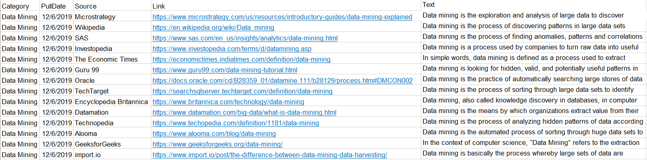
Example
Also called and instance, an example is a individual, independent subset of data.
You can think of it as a row of data.

Slide 7
Example
When taking data from a Database it may be necessary to denormailze the data to get one example across the data. Recall Relation and Joins from Databases.
ID | Student | Year | Enrolled
ID | Degree

Slide 8
Example
Denormalizing data may lead to “multi-instance” data.
Example:
1, Anne, Junior, 2015, Computer Science
1, Anne, Junior, 2015, Applied Mathematics
2, Bob, Freshmen, 2019, Biology
… becomes ...
1, Anne, Junior, 2015, Computer Science, Applied Math
2, Bob, Freshmen, 2019, Biology

Slide 9
Attribute
Also called features, factors, or variables, an attribute is one of many finite predefined elements that make up an example.
Each attribute of each example will have a value (hopefully).

Slide 10
Levels of Measurement

Slide 11
Types of Problems
The techniques we can use and the types of problems we can address are defined by the data we have.
Numeric-Attributes Problems
All attributes are numeric
Mixed Attributes Problems
Not all attributes are numeric
https://towardsdatascience.com/super-bowl-prediction-model-99048f366fed
https://pdfs.semanticscholar.org/6ca7/b53455585b484afef120cfea75ebfc84f7d6.pdf

Slide 12
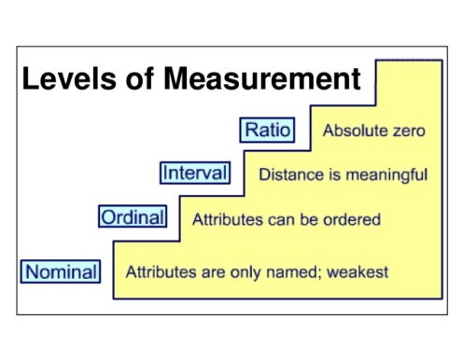
https://www.kdnuggets.com/2015/08/statistics-understanding-levels-measurement.html

Slide 13
Level of Measurement
Nominal
A named label.
Ordinal
A named label, and ordering or hierarchy to the labels.

Slide 14
Level of Measurement
Interval
A named label, ordering or hierarchy to the labels, and a fixed distance between neighboring labels.
Ratio
A named label, ordering or hierarchy to the labels, a fixed distance between neighboring labels, and a zero value means the absence of what is being measured.

Slide 15
Name the Level of Measurement
Boolean
Student Number
Platelet Count
Likert Scale
Temperature in Celsius
Number of Students in the Class
Temperature in Kelvin
Nominal
Nominal
Ratio
Ordinal
Interval
Ratio
Ratio

Slide 16
Issues with Data

Slide 17
Possible issues with data
Sparse Data
Missing Values
Inaccurate Values
Unbalanced Data
Scale Difference
Proxy Variables

Slide 18
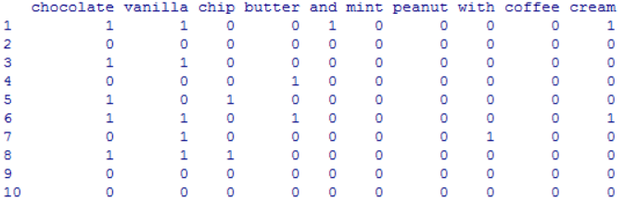
Sparse Data
Word frequency of words from 5165 documents.
http://marketing-yogi.blogspot.com/2012/12/session-7-r-code-for-in-class-work.html

Slide 19
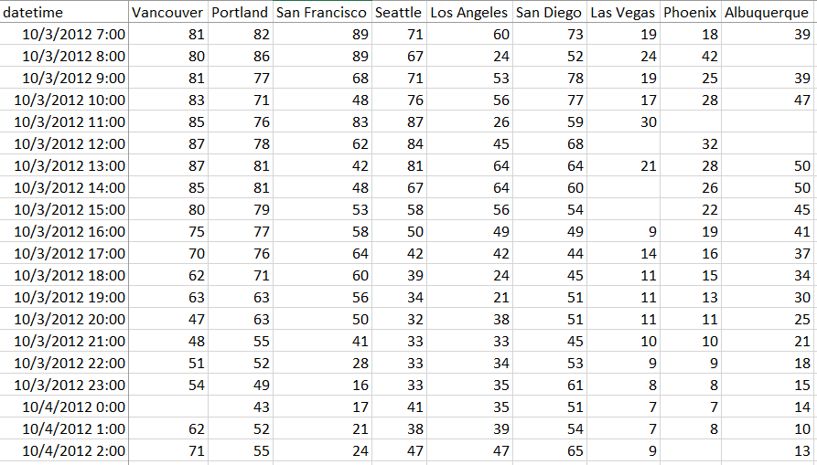
Missing Values

Slide 20
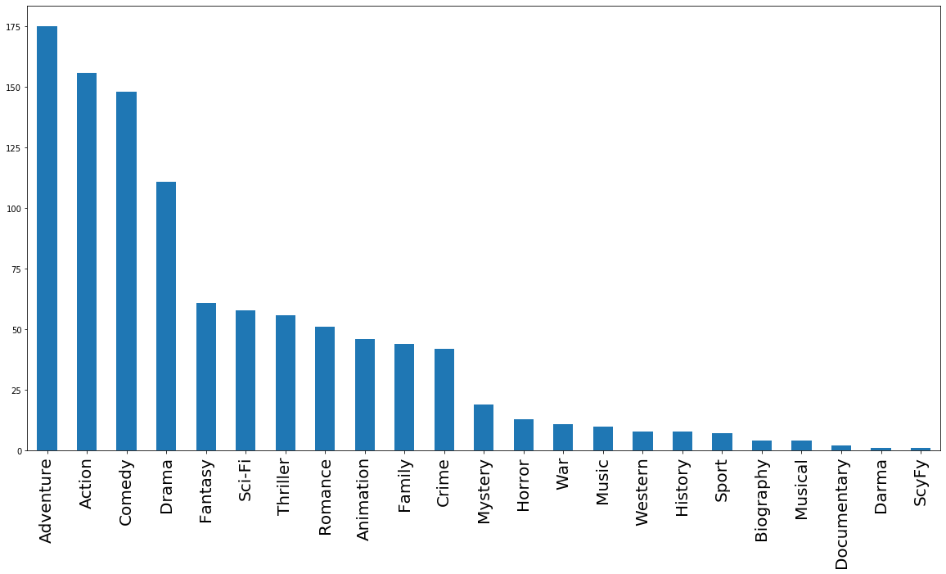
Inaccurate Values
Inaccurate Values can cause issues with analysis.

Slide 21
Unbalanced Data
An Unbalanced Data set is a situation when performing a classification problem and the data as significantly more members of one class than the other.

Slide 22
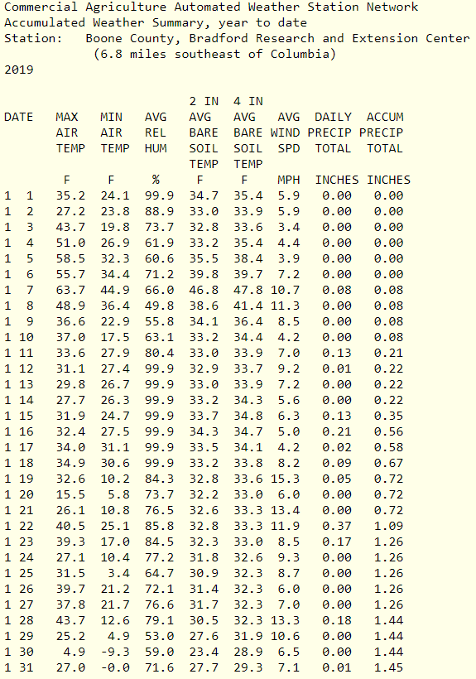
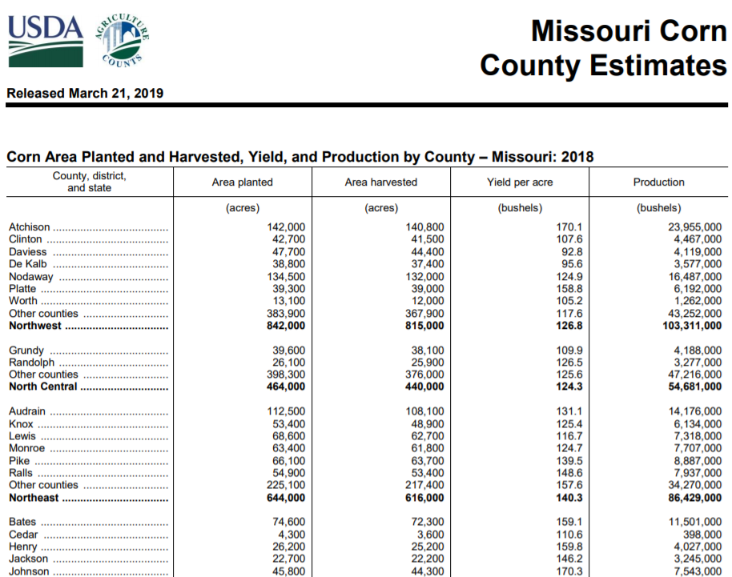
Scale Difference
http://agebb.missouri.edu/weather/stations/boone/index.htm
https://www.nass.usda.gov/Statistics_by_State/Missouri/Publications/County_Estimates/2018/MO-Corn-Production-by-County.pdf

Slide 23
Scale Difference
Normalization of data means rescaling the data values of an attribute to fit into a range between 0 and 1.
Normalized Value = (value – min(Values)) / (max(Values) - min(Values))

Slide 24
Scale Difference
Standardization of data means rescaling the data values of an attribute to fit into a range between 0 and 1 standard deviation.
Standardized Value = (value – mean(Values)) / (standard deviation (Values))

Slide 25
Bias in Data Mining

Slide 26
Riddle me this...
A father and his son are in a car accident. The father dies at the scene and the son is rushed to the hospital.
At the hospital the surgeon looks at the boy and says "I can't operate on this boy, he is my son."
How can this be?

Slide 27
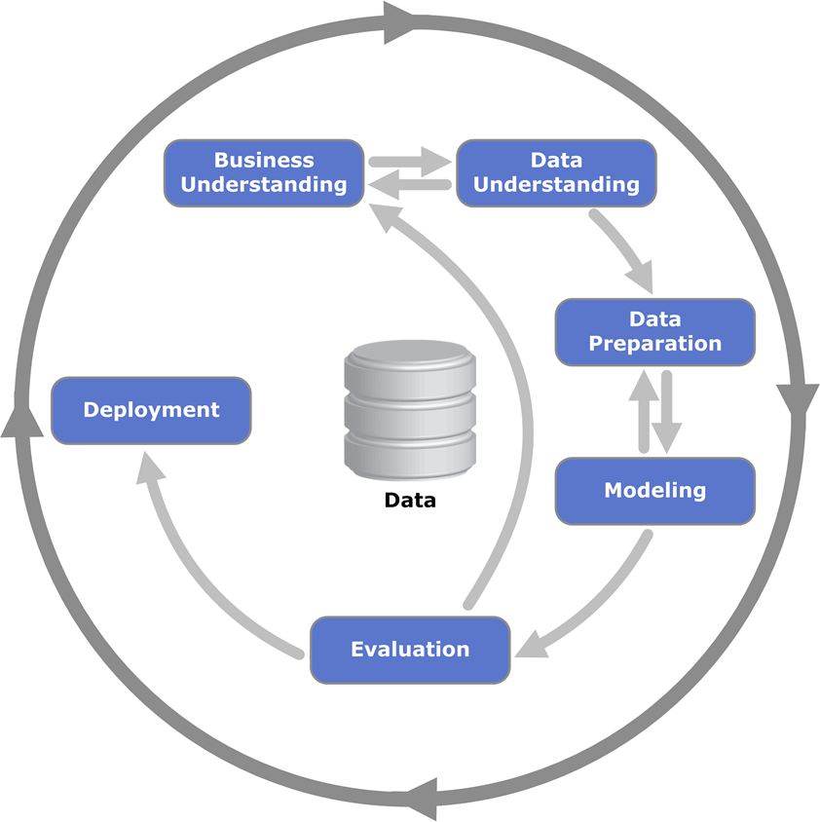
Bias in Data Mining - Where is Introduced?

Slide 28
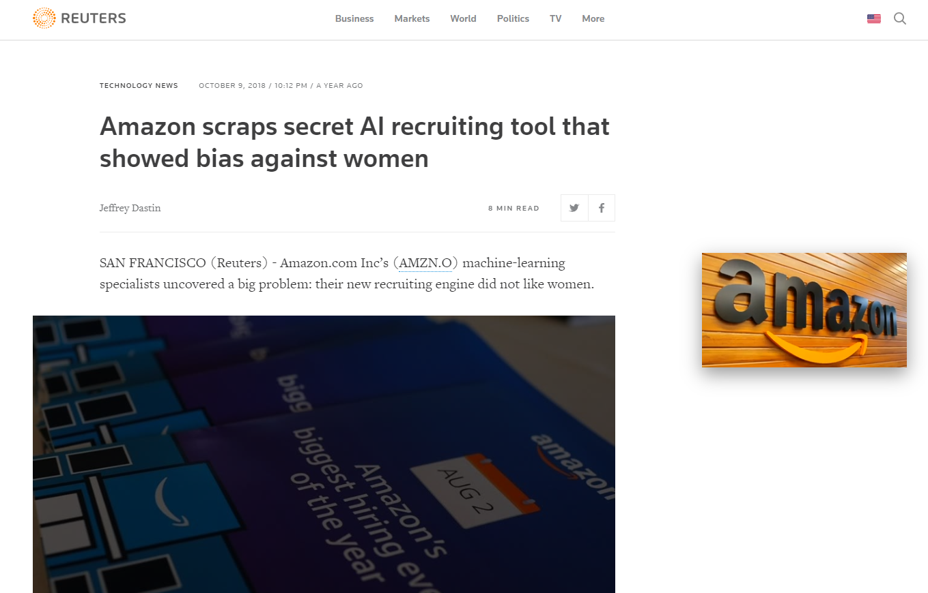
Bias in Data Mining
Automatically categorizing written texts by author gender
(Koppel, Argamon, & Shimoni, 2002)
https://www.reuters.com/article/us-amazon-com-jobs-automation-insight/amazon-scraps-secret-ai-recruiting-tool-that-showed-bias-against-women-idUSKCN1MK08G

Slide 29
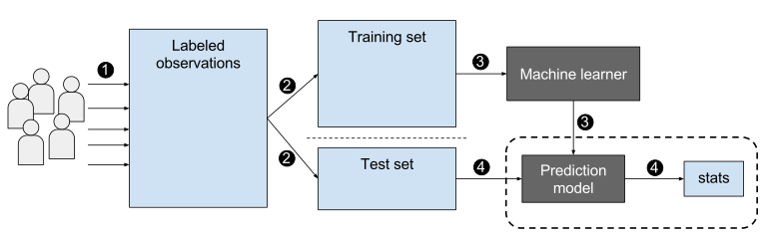
Bias in Data Mining - From Data Set
Supervised Learning
https://upload.wikimedia.org/wikipedia/commons/0/09/Supervised_machine_learning_in_a_nutshell.svg

Slide 30
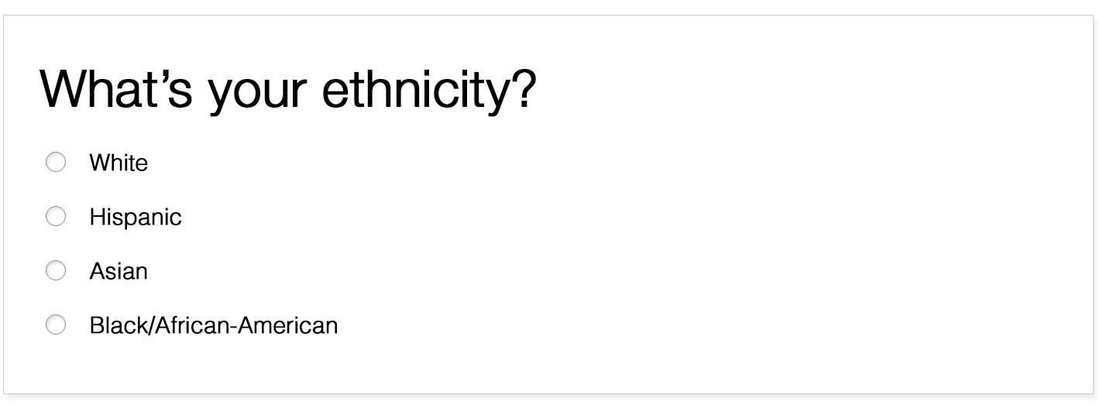
Bias in Data Mining - From Data Collection

Slide 31
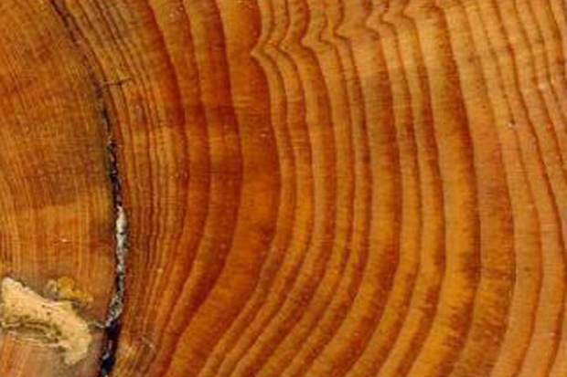
Bias in Data Mining - Proxy Variables
Some variables can approximate, or stand in as proxy, for another variables.
Tree rings stand in for a trees age.
https://www.climate.gov/news-features/blogs/beyond-data/how-tree-rings-tell-time-and-climate-history

Slide 32
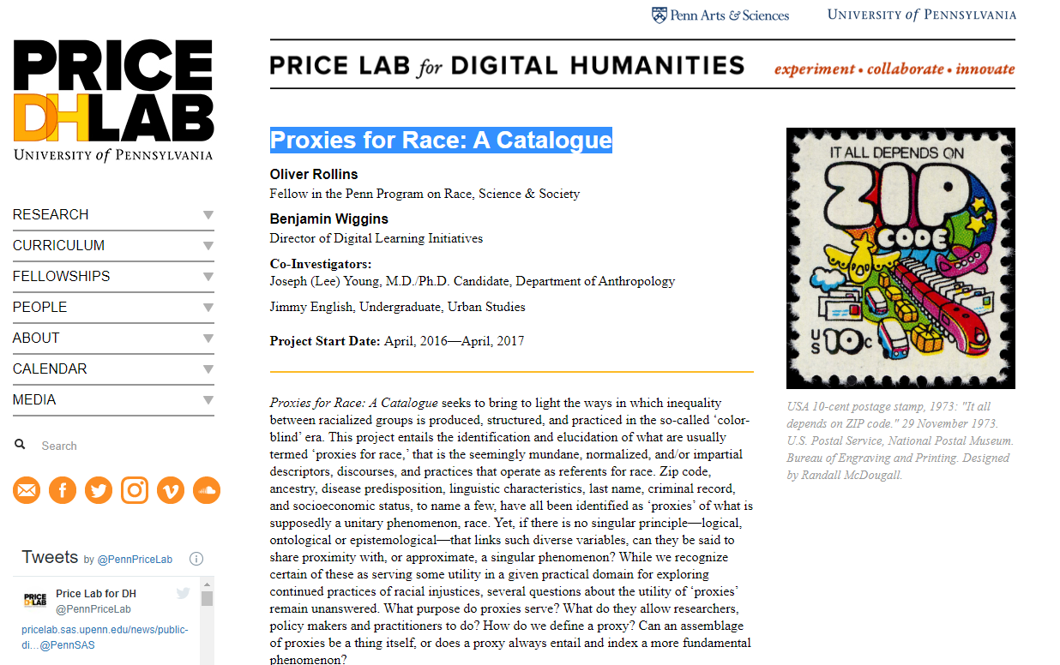
Bias in Data Mining - Proxy Variables
https://pricelab.sas.upenn.edu/projects/proxies-race-catalogue

Slide 33
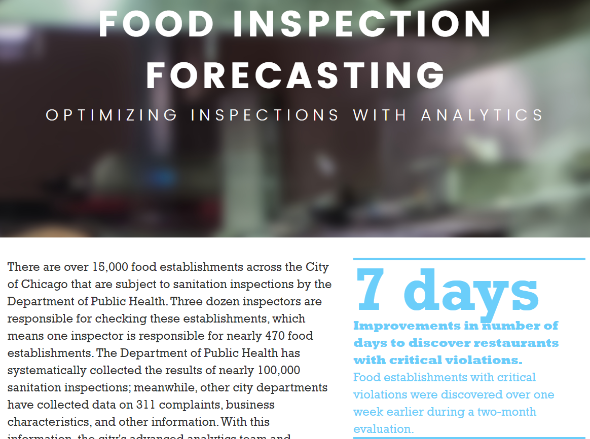
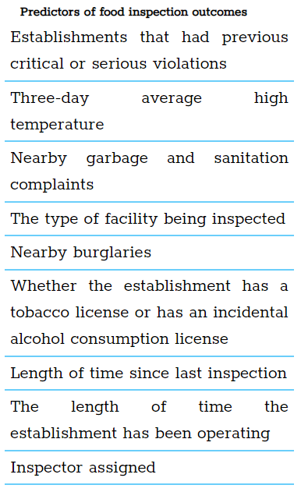
Bias in Data Mining - Biased Models
https://chicago.github.io/food-inspections-evaluation/

Slide 34
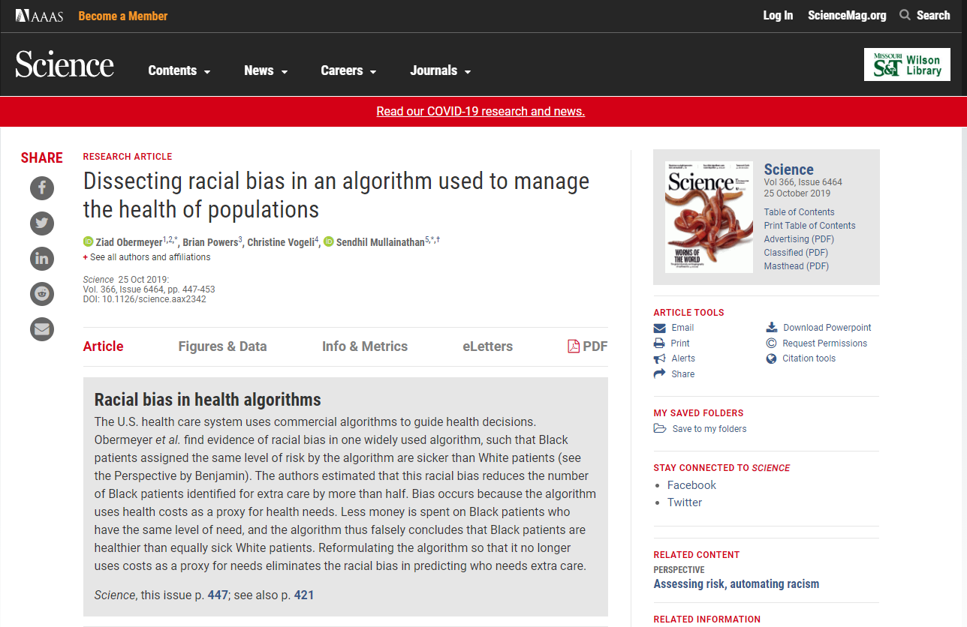
Bias in Data Mining - Biased Models

Slide 35
More Vocabulary

Slide 36
Closed World Assumption
The Closed World Assumption is the presumption that a statement that is known to be true is true, and a statement that is unknown is false.

Slide 37
Ground Truth
Information provided by direct observation, also called empirical evidence.

Slide 38
What We Learned
Vocabulary
Levels of Measure
Issues with Data
Bias in Data Mining
More Vocabulary

Slide 39
References
Koppel, M., Argamon, S., & Shimoni, A. R. (2002). Automatically categorizing written texts by author gender. Literary and linguistic computing, 17(4), 401-412.
Obermeyer, Z., Powers, B., Vogeli, C., & Mullainathan, S. (2019). Dissecting racial bias in an algorithm used to manage the health of populations. Science, 366(6464), 447-453.
Witten, I. H., Frank, E., Hall, M. A., & Pal, C. J. (2016). Data Mining: Practical Machine Learning Tools and Techniques.

